Slide 1

Population Growth Prediction using Linear Regression
SHRI VAISHNAV VIDHYAPEETH VISHWAVIDHYALAYA
Presented By –
Krati Choudhary (18100BTCSAII02843)
Abhijith Nair (18100BTCSAII02827)
Nayan Bhile (18100BTCSAII02847)
Akshata Gupta (18100BTCSAII02828)
Guided By –
Mr. Gaurav Thulla

Slide 2
POPULATION GROWTH PREDICTION
Population growth is a major factor to be considered while determining the development of a country.
Population forecasts are to be used to inform policy decisions regarding public pension systems, health care costs, environmental policy, or economic development strategies, then their uncertainty should be assessed and accurately portrayed.

Slide 3
APPLICATION APPROACH
Understand Linear Regression
Collect and Prepare the Data
Visualize Data (Understand the Data)
Normalize the Features
Create Linear Regression Model
Predict Using Linear Regression Model

Slide 4
DATASETS
Input Variables:
Output Variables
Existing trend of population growth throughout the years.
Birth rate
Death rate
Life expectancy
Prediction of population growth in coming years.

Slide 5
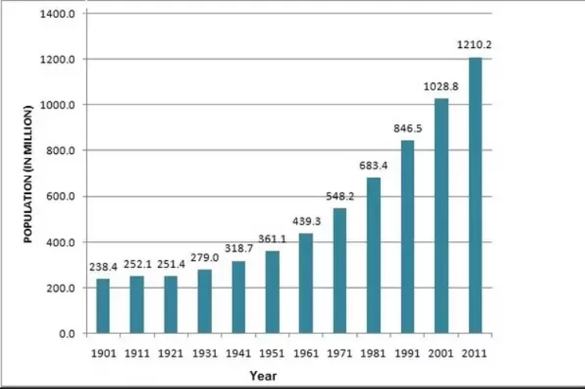
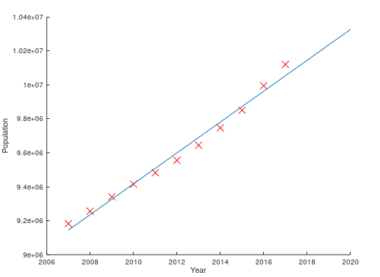
REGRESSION TURNOUT
Existing trend of population growth
Population growth prediction

Slide 6
THANK YOU

